Slide 1
SE-3002 Software Quality Engineering
Lecture 2-Chapter 1
Overview and Basics
Alina Arshad
alina.arshad@nu.edu.pk

Slide 2
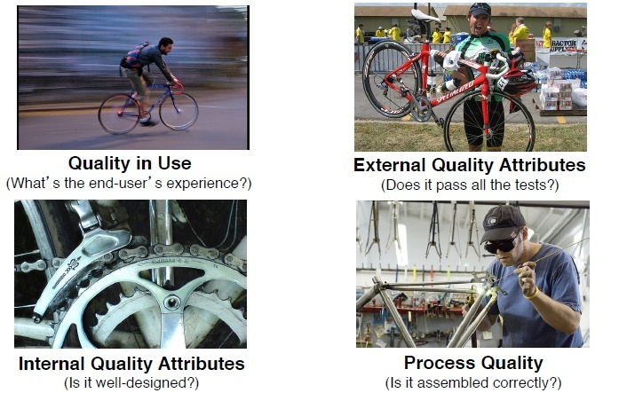
Different views of Quality

Slide 3
Quality Control vs Quality Assurance
Quality Control (QC)
Set of activities for ensuring quality in products.
The activities focus on identifying defects in the actual products produced.
Reactive process.
Identify defects after a product is developed and before it's released
Example Inspection, review, testing.
Quality Assurance
Set of activities for ensuring quality in the processes by which products are developed.
QA aims to prevent defects with a focus on the process used to make the product. It is a proactive quality process.
The goal of QA is to improve development and test processes so that defects do not arise when the product is being developed.
Auditing, reporting, data analysis.
Notes:
QC focuses on the product to find defects that remain after development. It is a reactive because it focus to identify defects after they occurs
QC professionals find these issues in a variety of ways, including software testing and beta or canary testing.
QA primarily focuses on the processes and procedures that improve quality, including training, documentation, monitoring and audits. QA is proactive because it focus to prevent defects before they occurs

Slide 4
What is the difference b/w QA & QC?
I was shocked today when I heard my neighbor telling his son the difference between Email and Gmail. He said Email is when you use Electricity to send mail while Gmail is when you use Generator to send mail. I'm still struggling to catch my breath!!
Notes:
Incorrect assumptions between qa and qc
Quality Assurance (QA): Like understanding the difference between Email and Gmail correctly from the beginning, QA is about ensuring that the processes used to manage and create deliverables are applied correctly
Quality Control (QC): On the other hand, if someone incorrectly believes that Gmail requires a generator, the result would be faulty usage.
Like understanding the difference between Email and Gmail correctly from the beginning,

Slide 5
Benefits of Quality Software
From Customer’s perspective
Customer satisfaction
Improved software reliability
Reduced errors during software operation
Matching the customer’s requirement
From Organization’s perspective
Customer’s requirements are met
Stability of requirements
Processes are applied in consistent manner
Process is improved over time

Slide 6
Testing, Quality Assurance, and Software Quality Engineering
By running the software system or executing its prescribed functions, testers can determine if the observed system behavior conforms to its specifications or requirements
Beyond testing, there are many other QA alternatives supported by related techniques and activities, such as inspection, formal verification, defect prevention, and fault tolerance
In addition, all these QA activities need to be managed in an engineering process we call the software quality engineering process, with quality goals set early in the product development, and strategies for QA selected, carried out, and monitored to achieve these preset quality goals

Slide 7
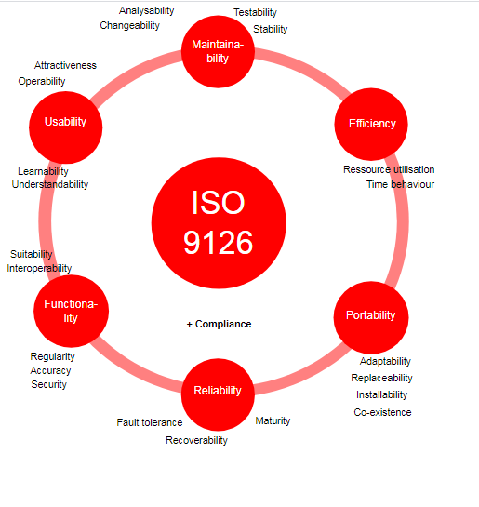
Quality Frameworks and ISO-9126

Slide 8
Quality Frameworks and ISO-9126
ISO-9126—hierarchical framework for quality definition, organized into quality characteristics and sub-characteristics with six top-level quality characteristics/dimensions:
Functionality: what is needed? (Suitability, Accuracy, Interoperability, Security)
Reliability: function correctly (Maturity, fault tolerance, recoverability)
Usability: effort to use (Understandability, learnability, operability)
Efficiency: resource needed (Time, resource)
Maintainability: correct/improve/adapt (Analyzability, changeability, stability, testability)
Portability: one environment to another (Adaptability, installability, conformance, replaceability)

Slide 9
Alternative frameworks and focus on correctness
Quality measure for IBM,s software products
CUPRIMDS (capability, usability, performance, reliability, installation, maintenance, documentation, and service)
Quality attributes for Web-based applications
reliability, usability, and security—primary attributes
availability, scalability, maintainability, and time to market—secondary attributes
performance (or efficiency) and reliability would take precedence over usability and maintainability for real-time software products. On the contrary, it might be the other way round for mass market products for end users.
Correctness is typically the most important aspect of quality for situations where daily life or business depends on the software

Slide 10
Correctness And Defects
The IEEE Standard 610.12 (IEEE 1990) defines the following terms related to defects.
Failure: The inability of a system or component to perform its required functions within specified performance requirements.
Fault: An incorrect step, process or data definition in a computer program.
Error: A human action that produces an incorrect result.
Defect (bug):All the above three terms collectively

Slide 11
Correctness and Defects
We also extend errors to include error sources or the root causes for the missing or incorrect actions, such as human misconceptions, misunderstandings, etc.
Moreover, we use defect detection and removal for the overall concept and activities related to what many people commonly call “debugging”.
Specific activities related to defect discovery, including testing, inspection, etc.
Specific follow-up activities after defect discovery,

Slide 12
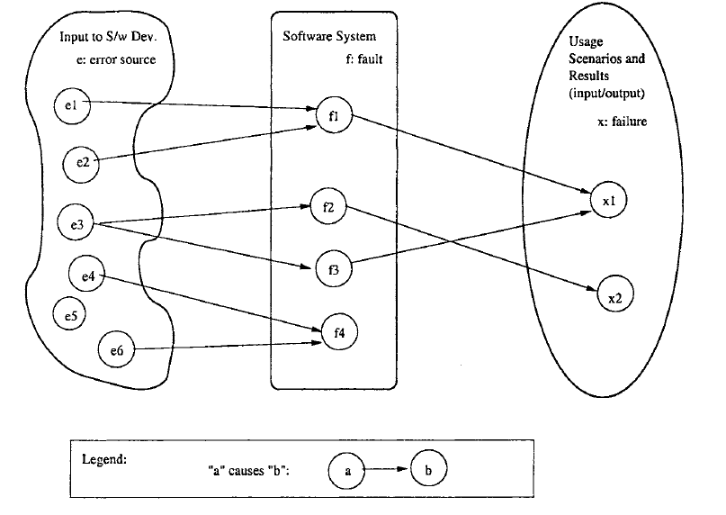
Defect related concepts & relations

Slide 13

Defect related concepts & relations
The relationship among three aspects of defects is
Errors may cause faults and faults may cause failures.
This relationship is not necessarily 1-to-1.
A single error may cause many faults and a single fault may cause many failures.
Conversely, the same failure may be caused by several faults and same fault may be caused by many errors.

Slide 14
Defect related concepts & relations
Examples
e3 causes multiple faults f2 and f3.
f1 is caused by multiple error sources e1 and e2.
Sometimes an error source (e5) may not cause any fault and a fault (f4) may not cause any failure under the given scenario. Such faults are called dormant or latent faults.

Slide 15
Software development models
There are numerous models for software development that are process oriented in approach.
Each model defines its own steps, processes, procedures and activities to be followed under a software development life-cycle.
While discussing about conventional software development, Waterfall model and Spiral model may be specified as more mature and practiced.

Slide 16
Waterfall Model
Requirements
Specification
Design
Coding
Unit
Testing
Integration
Testing
Installation &
Training
Maintenance

Slide 17
Waterfall and SQA Activities
Requirements
Specification
Review the SRS
Defect Tracking
Documentation
Configuration Control
Design
Design Reviews
Coding
Standards
Coding
Unit
Testing
Test Procedures
and Tolerances
Integration
Testing
Validation
Installation &
Training
Maintenance

Slide 18
Spiral Model
Test
Risk Analysis &
Specification
Code
Design

Slide 19
Spiral with SQA
Risk Analysis &
Specification
defect tracking
Regression
Testing
Test
Specification Review
Design
Code
Design
Review

Slide 20
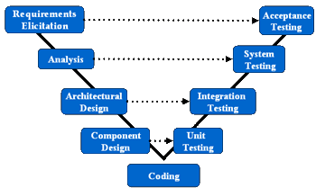
The V Model

Slide 21
Agile Development
Agility = ability to react to changing situations quickly, appropriately, and effectively.
notice changes early
initiate action promptly
create a feasible and effective alternative plan quickly
reorient work and resources quickly and effectively

Slide 22
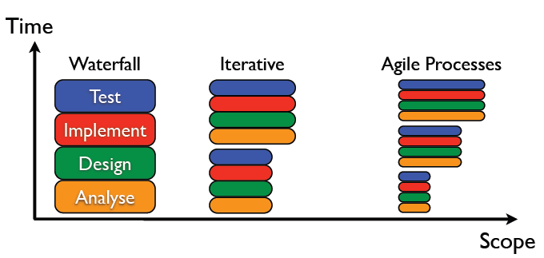
Agile Process

Slide 23
SQA under Agile development
Testing is a QA activity.
In conventional development approach, testing is conducted as a separate and complete phase.
Agile development changed the whole scenario of software testing.
Agile shifted the responsibility of testing to developers by adopting the techniques like Pair Programming and Test Driven Programming.
Testing is integrated in each iteration that helps to shorten the release time and provides with better quality.

Slide 24
Any question????

